Slide 1


CEF440 INTERNET PROGRAMMING & MOBILE PROGRAMMING
NetLinq
Bridging the Gap Between Network Performance and User Experience
Real-Time QoE Monitoring Platform
CEF440 INTERNET PROGRAMMING & MOBILE PROGRAMMING GROUP 23

Slide 2

Poor Network Experience Is Still a Daily Reality
Slow Internet Performance
Video Buffering
THE MISSING LINK
Real User Quality of Experience (QoE)
Unstable Connections
Frequent Outages
"Network performance alone doesn't tell the whole story."

Slide 3

Why This Matters
89%
83%
Depend on mobile internet for daily activities
Report slow internet as their primary connectivity issue
69%
84%
Experience network problems frequently throughout the day
Would actively use a QoE monitoring application
PROBLEM VALIDATED. SOLUTION NEEDED.

Slide 4

Our Solution
NetLinq
Automatic Monitoring
SEAMLESS BACKGROUND COLLECTION
A lightweight Android platform designed for real-time Quality of Experience (QoE) monitoring and analysis.
Smart QoE Feedback
CONTEXT-AWARE USER INPUT
Analytics Dashboard
REAL-TIME PERFORMANCE INSIGHTS
Offline Synchronization
RELIABLE DATA PERSISTENCE
Privacy-First Design
SECURE DATA HANDLING

Slide 5


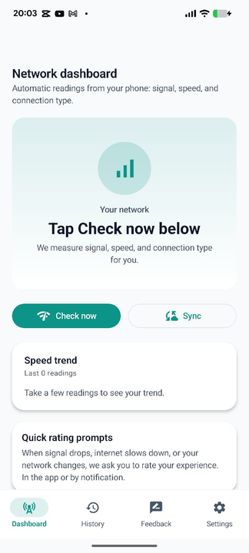
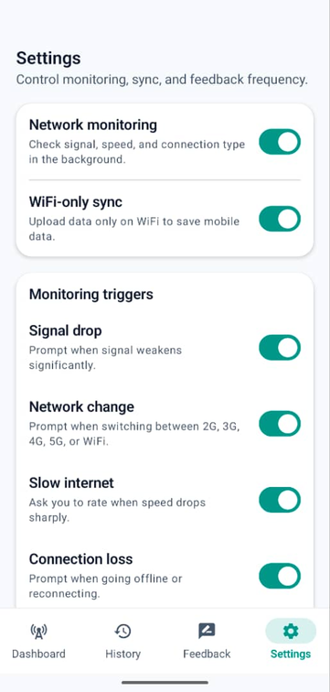
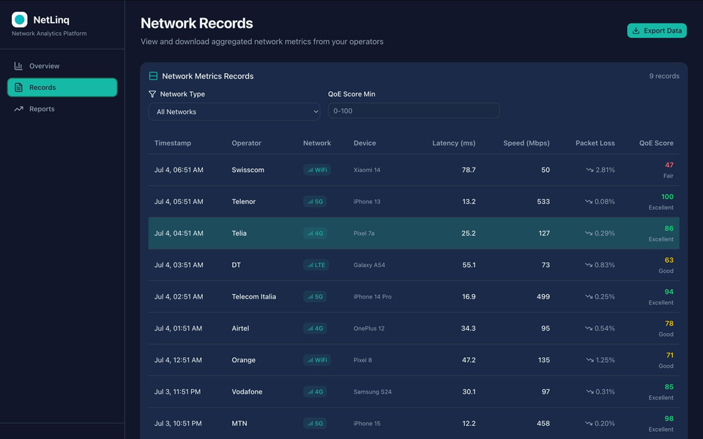
Our Product’s Features
Anonymous and Aggregated
Simple
Configurable

Slide 6

Tools and Technology Stack
Frontend(Mobile Subscriber)
Room Database(Mobile Subscriber)
Kotlin + Jetpack Compose
Hilt(Database Model.kt) and connected to repositories
MVVM Architecture
Kotlin
Android Studio
Web Frontend(Network Operators)
PostgresSQL Database(supabase)
React js
RLS policies
Vercel
Regulatory policies

Slide 7
SWOT Analysis
STRENGTHS
WEAKNESSES
Real-time QoE collection
Android-only MVP
Lightweight architecture
User reluctance toward data sharing
Privacy-conscious design
OPPORTUNITIES
THREATS
Operator integration
Privacy concerns & regulations
Cross-platform expansion
Android OS restrictions
AI-powered QoE prediction
Regulatory policies

Slide 8
Collaboration
GITHUB
Weekly meetings
For version Control and Collaboration
For Brainstorming,Decision making and Implementation

Slide 9

The Road Ahead
TODAY
MVP Launch
Core QoE Monitoring & Android Platform
PHASE 2
Operator Integration
Direct Data Pipelines for Network Providers
PHASE 3
Cross-Platform Support
Expansion to iOS and Web Dashboards
PHASE 4
AI-Powered Prediction
Proactive Network Experience Forecasting
"From monitoring networks to predicting network experience."

Slide 10

"Better networks begin with better user insights."
NetLink
BRIDGING QOS AND QOE
THANK YOU

